Slide 1
Introduction to Computer Science (371-1-1601)
Lectures by: Dr. Dan Vilenchik & Dr. Zion Siksik
Recitations by: Ariel Cohen, Moshiko Davidian, Assaf Livne, Yair Mazal

Slide 2
Recitation 5 Enumerate, Dictionary, Error handling

Slide 3
Today's topics
Dictionary
Testing, debugging
Enumerate function
Error handling

Slide 4
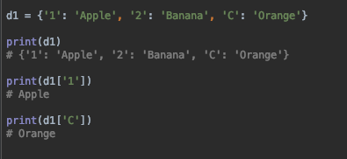
Dictionary

Slide 5
Dictionary
A dictionary is an unorganized list. Instead of indices it has key-value pairs:
d2 = {1: '1', 2: '2', 3: 3}
d3 = {'office': 97286421234, 'fax': 97286421234, 'mobile': 972526421234}
The order of the dictionary pairs is as the order of insertion (python 3.6+), but as we are using the dictionary keys, this order is meaningless.

Slide 6
Dictionary - methods
method | description
dict1.keys() | Return a list of the dictionary’s keys (actual type depends on python version)
dict1.values() | Return a list of the dictionary’s values (actual type depends on python version)
dict1.items() | Return a list of the dictionary’s (key, value) pairs (actual type depends on python version)
dict1.get(k, d) | Returns dict1[k] if dict1 has the key k, otherwise d (default d=None)

Slide 7
Dictionary - example
If we have a list of student names and grades, how can we find a specific student grade?
students_lst = [['Assaf', 90], ['Yair', 80], ['Alon', 70]]

Slide 8
Dictionary – example 1 -list
If we have a list of student names and grades how can we find a specific student grade?
def get_student_grade1(students_lst, name): ''' find a student name in the list and return his grade :param students_lst: a list of lists of students names and grades :param name: the desired student name as string :return: the desired student grade if found ( default = None ) ''' for student in students_lst: if student[0] == name: return student[1] return None print(get_student_grade1(students_lst, 'Alon'))

Slide 9
Dictionary - example
If we have a list of student names and grades how can we find a specific student grade?
students_lst = [['Assaf', 90], ['Yair', 80], ['Alon', 70]]
students_dir = {'Assaf‘: 90, 'Yair‘: 80, 'Alon‘: 70}

Slide 10
Dictionary – example 1
If we have a list of student names and grades, how can we find a specific student grade?
student_dir.get('Alon') student_dir['Alon']

Slide 11
Dictionary – example2
Let us use a dictionary to store a range of numbers squares:
sqr = {x: x**2 for x in range(3, 11, 2)}
How is it different than using a list?

Slide 12
Dictionary – example3
Dictionaries can be used to store complex data sets. While keeping everything indexed and organized:
phonebook_dict = {'meni': {'office': 97286421234, 'fax': 97286421234, 'mobile': 972526421234}, 'jinji': {'office': 97286421234, 'mobile': 972526421234, 'email': "mail_address@gmail.com"} }

Slide 13
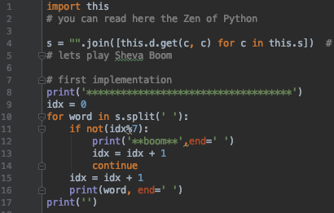
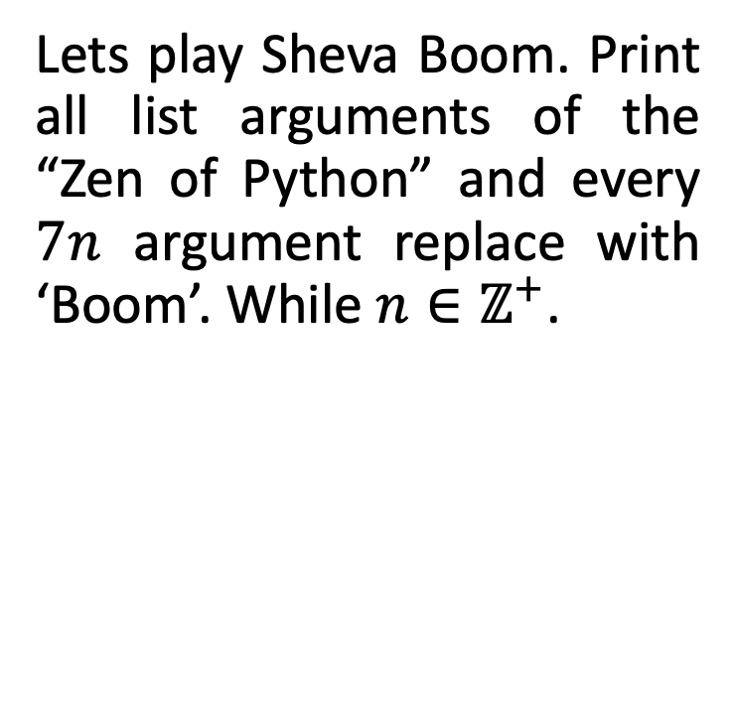
Enumerate function
Lets play Sheva Boom. Print all list arguments of the “Zen of Python” and every $7n$ argument replace with ‘Boom’. While $n∈ℤ^{+}$.

Slide 14
Enumerate function
Lets play Sheva Boom. Print all list arguments of the “Zen of Python” and every $7n$ argument replace with ‘Boom’. While $n∈ℤ^{+}$.

Slide 15
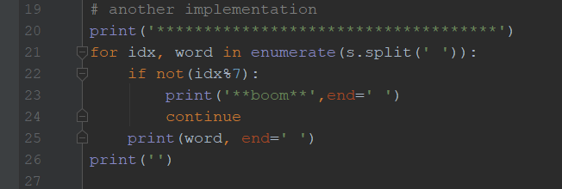
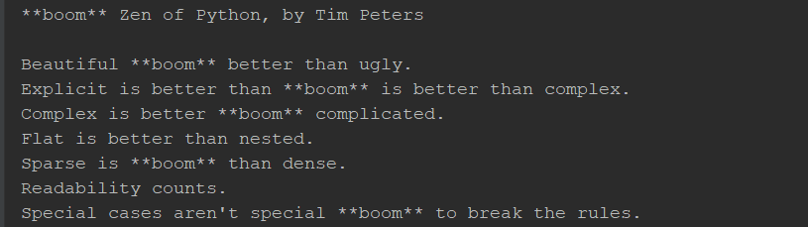
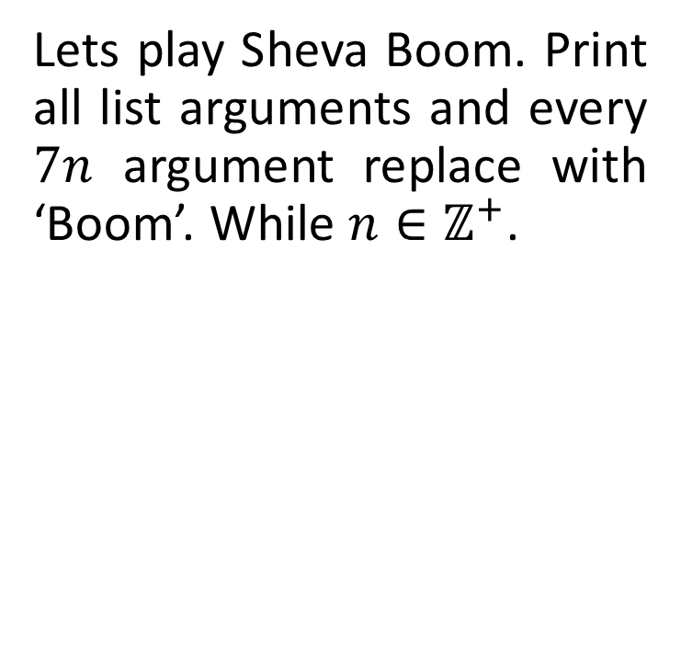
Enumerate function
Lets play Sheva Boom. Print all list arguments and every $7n$ argument replace with ‘Boom’. While $n∈ℤ^{+}$.

Slide 16
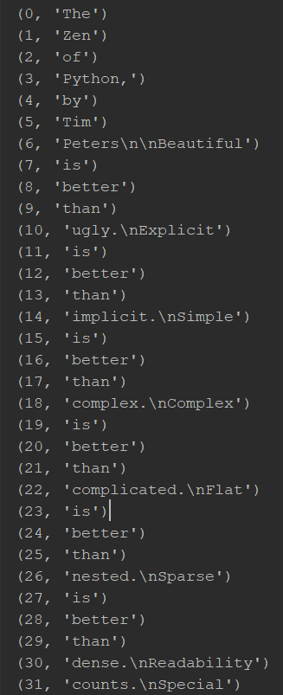
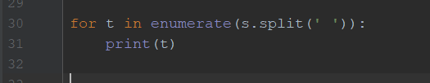
Let’s dive in

Slide 17

Testing and debugging
What are “bugs” ?
How can we debug them?

Slide 18
Testing and debugging
What are “bugs” ?
Computer programs flaws, mistakes, errors
How can we debug them?

Slide 19
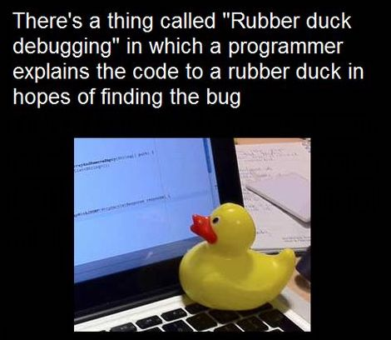
How can we debug?
Don’t Panic

Slide 20
How can we debug?
The process of debugging is circular, clearing one bug can reveal another:
Think
Write unit tests
Investigate variables ( debugger/ print)
Tips: Reduced problem, minimal iteration, manipulate the variables to find the problem

Slide 21
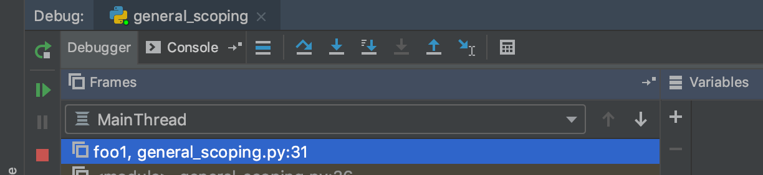
Debugger tools
Step over
Rerun
Step into
Step out
Resume
Stop

Slide 22
Class Example – Explain the code
def code_letters(str1, coding_dict, letter): str1.replace(letter, coding_dict[letter]) def abra(str1, dict1): for i in range(len(str1)): code_letters(str1, dict1, str1[i]) return str1 def kadabra(code): t = {chr(i): chr(i + code) for i in range(ord('a'), ord('z') + 1 )} t.update({chr(ord('z') - i): chr(code - i -1 + ord('a')) for i in range(code)}) return t
d = kadabra(5) print(abra("abrakadabra", d))

Slide 23
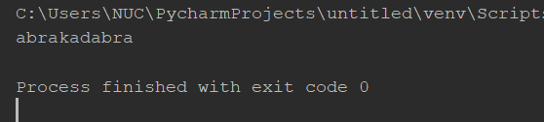
Class Example – can you find the problem?
def code_letters(str1, coding_dict, letter): str1.replace(letter, coding_dict[letter]) def abra(str1, dict1): for i in range(len(str1)): code_letters(str1, dict1, str1[i]) return str1 def kadabra(code): t = {chr(i): chr(i + code) for i in range(ord('a'), ord('z') + 1 )} t.update({chr(ord('z') - i): chr(code - i -1 + ord('a')) for i in range(code)}) return t
d = kadabra(5) print(abra("abrakadabra", d))

Slide 24
Error Handling : Try - except
What can we do with run time errors?
def divide_numbers(): d = input('Please enter the denominator: ') n = input('Please enter the numerator: ') print('The result is: ' + str(int(n)/int(d)))

Slide 25
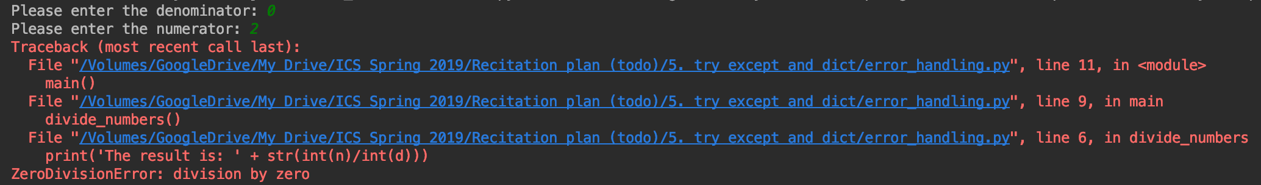
Error Handling : Try - except
def divide_numbers(): d = input('Please enter the denominator: ') n = input('Please enter the numerator: ') print('The result is: ' + str(int(n)/int(d)))

Slide 26
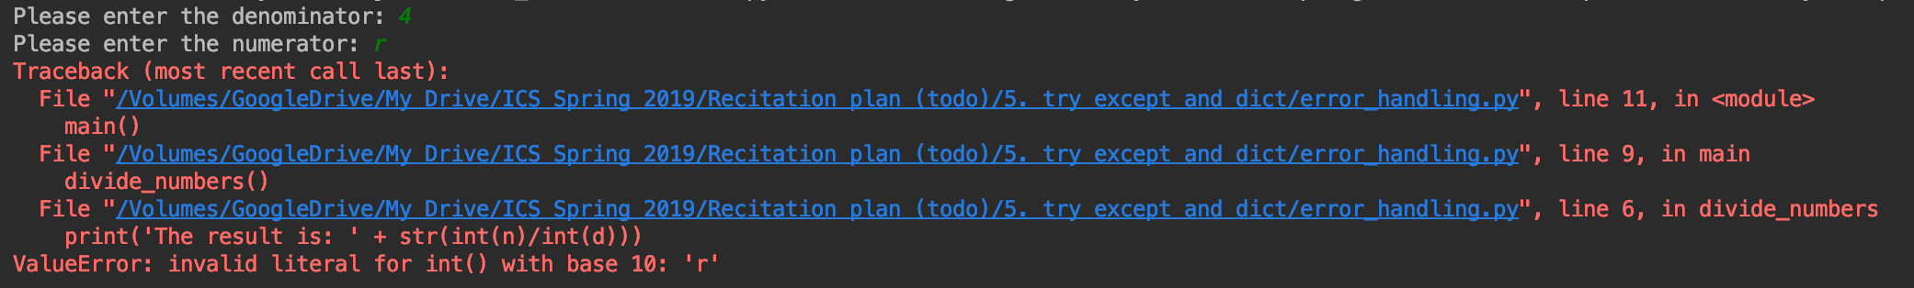
Error Handling : Try - except
def divide_numbers(): d = input('Please enter the denominator: ') n = input('Please enter the numerator: ') print('The result is: ' + str(int(n)/int(d)))

Slide 27
Error Handling : Try - except
We can use the try-except mechanism to “catch” the error and respond accordingly.
def divide_numbers_safe(): while True: try: d = input('Please enter the denominator: ') n = input('Please enter the numerator: ') print('The result is: ' + str(int(n)/int(d))) return except ValueError: print("\nPlease enter a number!! \n")

Slide 28
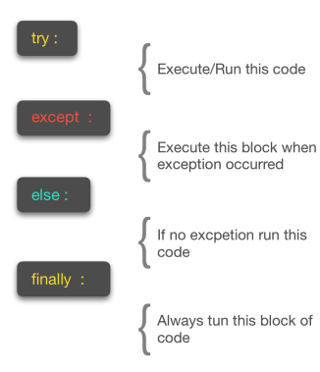
Error Handling : Try - except
We can also use “raise” to create an exception, which can be caught by this mechanism

Slide 29
Summary
We saw today how to use:
Enumerate function
Dictionaries
How to raise and handle exceptions

